Slide 1
Find the intervals in which the function
is i) increasing ii) decreasing

Slide 5
f(x) is increasing , when
or
f(x) is increasing in the interval

Slide 6
f(x) is decreasing , when
or
f(x) is decreasing in the interval

Slide 7
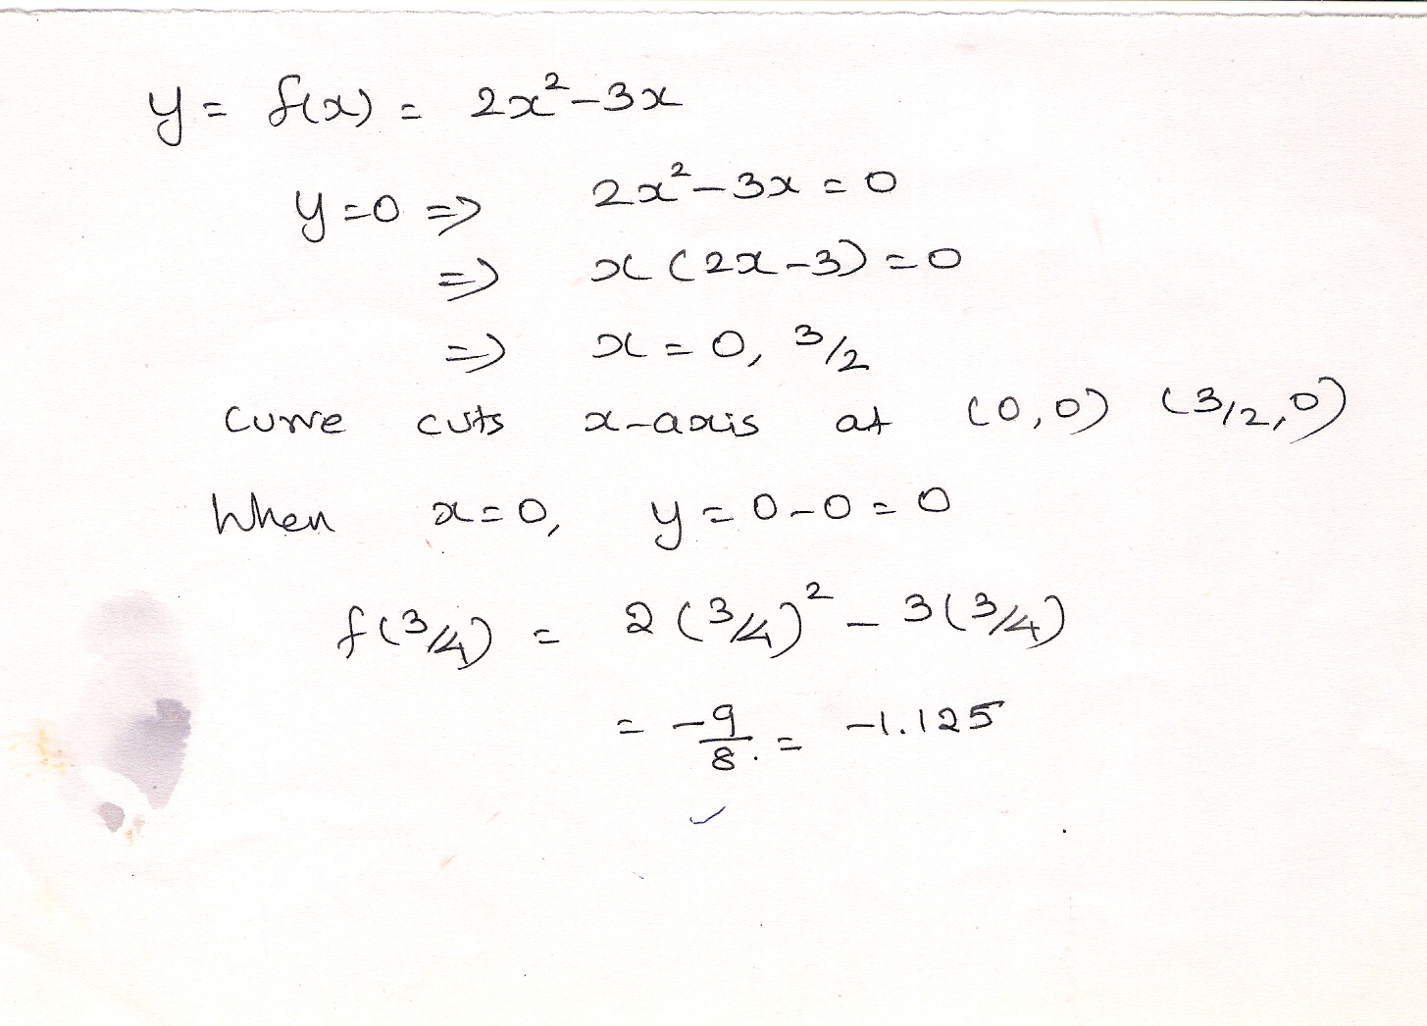

Slide 8
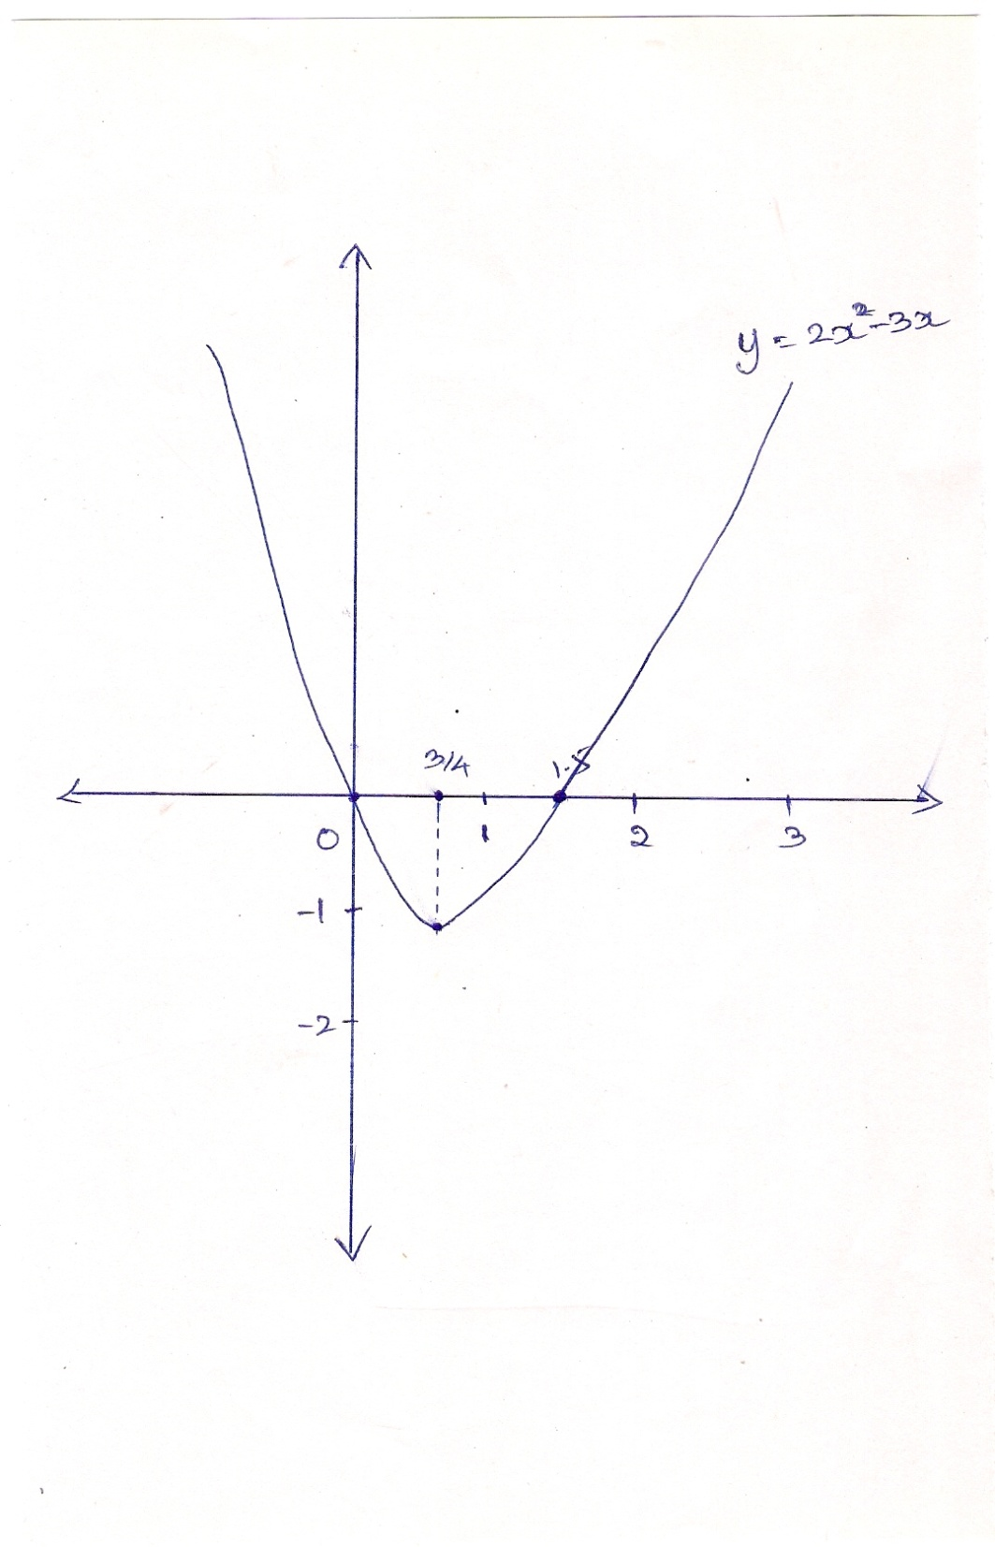

Slide 9
HOME WORK
Find the intervals in which the function
is i) increasing ii) decreasing

Slide 11
EVERY LINEAR FUNCTION
REPRESENTS A STRAIGHT
LINE IN THE CARTESIAN
PLANE

Slide 13
EVERY QUADRATIC FUNCTION
REPRESENTS A PARABOLA
(UPWARD OR DOWNWARD)
IN THE CARTESIAN PLANE

Slide 15
THE GRAPH OF A DERIVATIVE FUNCTION OF
A LINEAR FUNCTION WILL BE A STRAIGHT
LINE PARALLEL TO X-AXIS.

Slide 17
THE GRAPH OF A DERIVATIVE FUNCTION OF
A QUADRATIC FUNCTION WILL BE A STRAIGHT
LINE (OBLIQUE).

Slide 20
THE GRAPH OF A DERIVATIVE FUNCTION OF
A CUBIC FUNCTION WILL BE A PARABOLA
(UPWARD OR DOWNWARD)

Slide 23
Find the intervals in which the function
is i) increasing ii) decreasing

Slide 25
Find the intervals in which the function
is i) increasing ii) decreasing

