Slide 1
Find the intervals in which the function
is i) increasing ii) decreasing

Slide 5
f(x) is increasing , when
or
f(x) is increasing in the interval in

Slide 6
f(x) is decreasing, when
or
f(x) is decreasing in the interval in

Slide 7
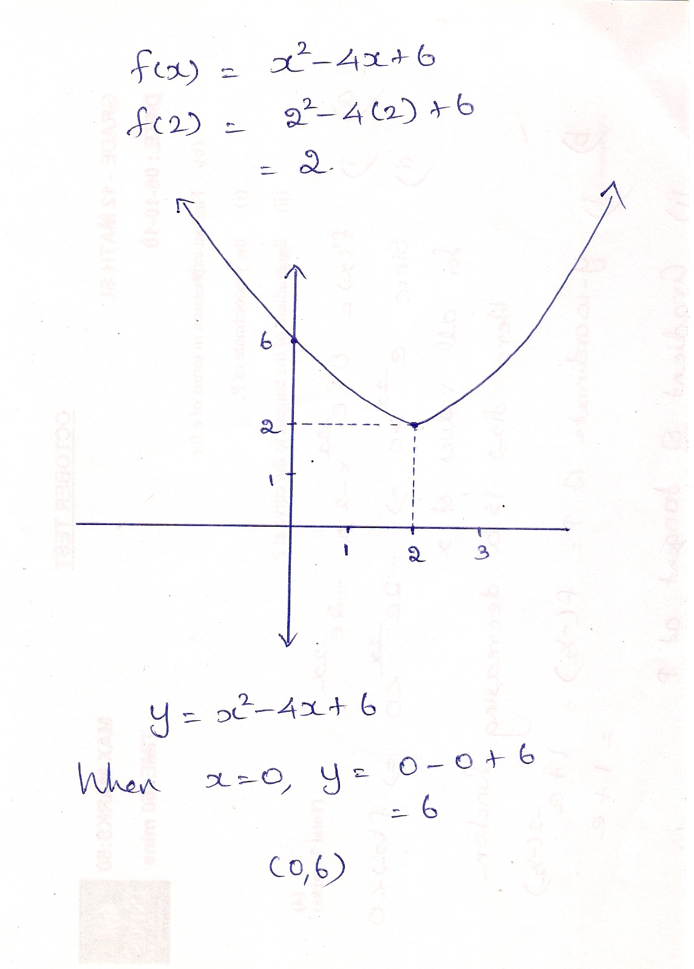

Slide 8
Find the intervals in which the function
is i) increasing ii) decreasing

Slide 13
f(x) is increasing , when
or
or
f(x) is increasing in the interval

Slide 14
f(x) is decreasing , when
or
f(x) is increasing in the interval

Slide 15
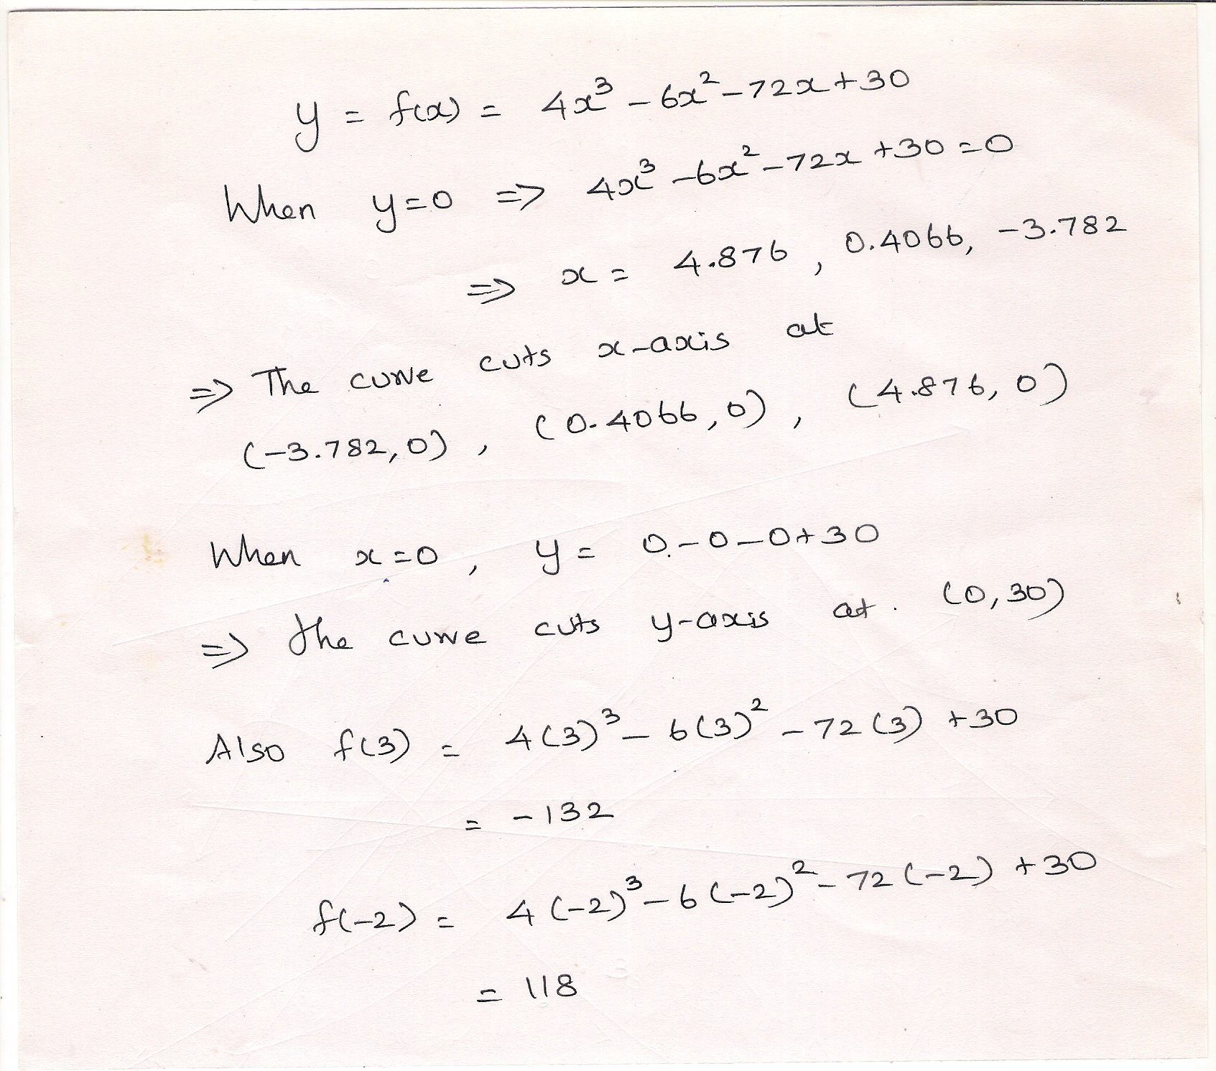

Slide 16
